Slide 1
KYAMBOGO UNIVERSITY • SCHOOL OF COMPUTING AND INFORMATION SCIENCE
An AI-Based Conversational Mental Health Support System
Case Study: Students of Kyambogo University
Supervisor Presentation | Research Report Briefing
Supervisor: Dr. Busobozi Vivian Viola
Department of Computer Science • August 2026

Slide 2
Research Team
Bachelor of Information Systems • Final Year Project
Piima Smith
Amuge Janet Noeline
Nabifo Milly Joan
Kasogwa Silas Job
Nsiime Andrew
23/U/ISD/12352/PD
24/U/ISE/0773/PE
23/U/ISE/09140/PE
23/U/ISD/06528/PD
24/U/ISE/1555/PE
Purpose of this briefing
To present the problem, objectives, methods, survey findings, system design, implementation, testing, and conclusions of the AI-based conversational mental health support platform developed for Kyambogo University students.
The system is designed as a complement to existing counselling services — not a replacement for professional care.
KyU Wellness | Supervisor Presentation | August 2026
2

Slide 3
Presentation Outline
1. Background and problem
7. Current counselling system (SWOT)
2. Purpose, objectives and questions
8. Requirements of the new system
3. Scope and significance
9. Design (DFDs and ERD)
4. Literature gap
10. Architecture and implementation
5. Methodology
11. Testing and validation
6. Survey data analysis (n = 79)
12. Discussion, recommendations, conclusion
KyU Wellness | Supervisor Presentation | August 2026
3

Slide 4
Background of the Study
Uganda’s mental health treatment gap
24.2% / 22.9%
< 1 in 10
50.9%
Adults / children in Uganda experience mental health conditions (State of Uganda Population Report, 2025).
People who need care receive appropriate support — a large treatment gap.
Youth (18–30) not in employment, education or training, contributing to distress and untreated depression.
• University counselling services are limited in staff, hours, and reach; stigma further reduces help-seeking.
• AI conversational agents (e.g. CBT-informed chatbots) can offer scalable, 24/7, stigma-reducing support.
• This study develops a specialised system for Kyambogo University students, with escalation to human counselors.
KyU Wellness | Supervisor Presentation | August 2026
4

Slide 5
Problem Statement
• Youth mental disorders are rising, yet timely, affordable, stigma-free care remains hard to access in universities.
• Shortage of trained professionals, social stigma, and financial barriers stop many students from seeking help.
• Existing AI tools are often poorly adapted to local culture, weakly validated clinically, and raise privacy concerns.
• Without a context-appropriate system, digital tools may be unused — or harmful through inaccurate assessments.
• Need: an AI-driven support system adapted to Kyambogo University students, linked to human counselors.
KyU Wellness | Supervisor Presentation | August 2026
5

Slide 6
Purpose and Objectives
Purpose / Main objective
To develop an AI-based conversational mental health support system that detects early signs of mental distress among Kyambogo University students through text-based interactions.
Specific objectives
Research questions
1. Explore variables associated with mental health distress among KyU students.
2. Design functional features required for an effective student mental health support system.
General: How can such a system be developed to detect distress in text?
1. What variables are associated with distress among KyU students?
2. What functional features are required for an effective system?
KyU Wellness | Supervisor Presentation | August 2026
6

Slide 7
Scope of the Study
Subject scope
Geographical scope
Time scope
Design, development and testing of KyU Wellness:
• Auth (student/guest)
• PHQ-9, GAD-7, PSS-10
• CBT-informed AI chat
• Hybrid distress detection
• Crisis escalation
• Wellness, journal, appointments
• Counselor dashboard
Not covered: diagnosis, full therapy, or replacing professional counselling.
Kyambogo University, Uganda.
Designed for students and counselling staff in the KyU community.
The platform is web-based, but data collection, design context, and intended users are centred on Kyambogo University.
March – August 2026.
Covered:
• Requirements gathering
• System design
• Implementation
• Testing
• Documentation
KyU Wellness | Supervisor Presentation | August 2026
7

Slide 8
Significance of the Study
Students
Mental health professionals
Accessible, stigma-free, immediate support when counselling is hard to reach.
Supplementary tool for early detection, monitoring, and more targeted care.
Policymakers
Academia
A scalable, cost-effective model aligned with equitable care goals (WHO, 2022).
Local evidence on AI in mental health, cultural fit, ethics, and evaluation.
KyU Wellness | Supervisor Presentation | August 2026
8

Slide 9
Literature Gap
Chapter Two
• Student distress is often undetected until it becomes severe (academic, financial, social, personal stressors).
• Most conversational AI evidence comes from foreign contexts, not Ugandan universities.
• Tools such as Wysa show potential, but few systems combine: local context + text support + crisis detection + counselor escalation.
• Gap: a culturally and institutionally relevant system for Kyambogo University that detects early distress and enables timely counselor intervention.
KyU Wellness | Supervisor Presentation | August 2026
9

Slide 10
Methodology
Mixed-methods case study
Design
Population / sample
Data collection
Qualitative + quantitative case study at Kyambogo University to explore distress factors and design a relevant AI system.
Undergraduates 18–30 with internet access.
Survey: 79 completed responses.
Interviews: 10–20 (purposive).
Online questionnaire (PHQ-9, GAD-7, PSS-10) and student interviews on stressors and help-seeking.
System study
System analysis
Design models
Document analysis and observation of counselling workflows and digital wellbeing practices (Yin, 2017).
Use cases (Cockburn, 2000) and process mapping (Damelio, 2011) for auth, chat, assessments, escalation.
DFDs for processes; E-R diagrams for the PostgreSQL schema.
KyU Wellness | Supervisor Presentation | August 2026
10

Slide 11
Data Analysis Methods
Responses.xlsx • 79 consented students
Quantitative (Excel)
Qualitative (content analysis)
Descriptive statistics were used for closed items:
• Frequencies and percentages for demographics
• Means and Standard Deviations for PHQ-9, GAD-7, and PSS-10 scores
• Severity bands using established cut-offs
• Multiple-response counts for preferred features and concerns
This showed how common distress and AI acceptance were.
Three open-ended questions were coded thematically:
• Causes of student stress
• Current coping practices
• Suggested system improvements
This explained why students struggle and what they want from the system.
KyU Wellness | Supervisor Presentation | August 2026
11

Slide 12
Quantitative Findings
n = 79 Kyambogo University students
Sample
Distress scores
Crisis signal
59.5% male, 40.5% female. 53.2% aged 21–23. 60.8% Year 3. 44.3% from SCIS. 55.7% off-campus hostels. 63.3% not employed.
PHQ-9 mean 8.7; 41.8% moderate or above. GAD-7 mean 7.3; 32.9% moderate/severe. PSS-10 mean 20.2; 81.0% moderate, 13.9% high stress.
26.6% endorsed at least some thoughts of self-harm on PHQ-9 item 9 — supporting the need for distress detection and counselor escalation.
AI acceptance
Features and concerns
34.2% had used a digital Mental Health tool before. 49.4% would feel comfortable using AI at Kyambogo University (38.0% maybe). 64.6% would recommend AI support for students.
Most wanted: anonymous counselling (57%), stress tips (52%), academic guidance (46%), chatbot (43%). Top concerns: privacy (68%), accuracy (49%), data security (44%).
KyU Wellness | Supervisor Presentation | August 2026
12

Slide 13
Qualitative Findings
Thematic content analysis of open-ended responses
Causes of stress
How students cope
What they want in the system
Financial pressure, poverty, and tuition were the most common themes (about 65% of answers), followed by academics, exams, and workload (33%), then relationships (18%). Distress is mainly financial and academic.
Most students self-cope: talking to friends, music, rest or walks, and prayer. Few mentioned professional counselling. This supports a low-barrier digital entry point before face-to-face help.
Privacy, confidentiality, and data security; easier use; practical solutions; and a link to human counselling or alerts when needed. These themes shaped guest access, chat, crisis escalation, and counselor tools.
KyU Wellness | Supervisor Presentation | August 2026
13

Slide 14
Current System: SWOT
Guidance and Counselling Unit — Students’ Welfare Department
Strengths
Weaknesses
Free, confidential professional counselling; individual/group/crisis/peer support; trained psychologists; student-focused issues.
Mostly face-to-face; few staff; office hours only; no automated early detection; relies on self-referral.
Opportunities
Threats
Digital health tools; 24/7 AI screening; integrate with existing unit; growing mental-health awareness.
Stigma; funding/staffing; distrust of digital tools; limited devices/internet/digital literacy.
KyU Wellness | Supervisor Presentation | August 2026
14

Slide 15
Requirements of the New System
Users
Assessments
AI chat + distress
Students, guests, counselors, admins — register/login, anonymous guest, bilingual EN/LG.
PHQ-9, GAD-7, PSS-10 with scores, severity, history and trends.
CBT-informed chat; hybrid rules + AI; levels low–crisis; escalate to counselors.
Wellness
Counselor tools
Quality
Mood, check-ins, journal, dashboard, appointments, feedback.
Alerts, caseload, student detail, appointment queue, feedback review.
Security (bcrypt, JWT, RBAC), privacy, usability, reliability, disclaimers.
KyU Wellness | Supervisor Presentation | August 2026
15

Slide 16
System Design — Data Flow Diagrams
Context diagram
Level 0 processes
Level 1 of Process 1.0
The system as one process.
External entities:
• Student
• Guest user
• Counselor / Admin
• Email / SMTP
• AI / LLM service
1.0 Authenticate users
2.0 Manage conversations
3.0 Conduct assessments
4.0 Detect distress & escalate
5.0 Track wellness
6.0 Appointments & feedback
7.0 Counselor monitoring
1.1 Register student
1.2 Authenticate login
1.3 Create guest session
1.4 Verify email
1.5 Reset password
1.6 Manage session tokens
KyU Wellness | Supervisor Presentation | August 2026
16

Slide 17
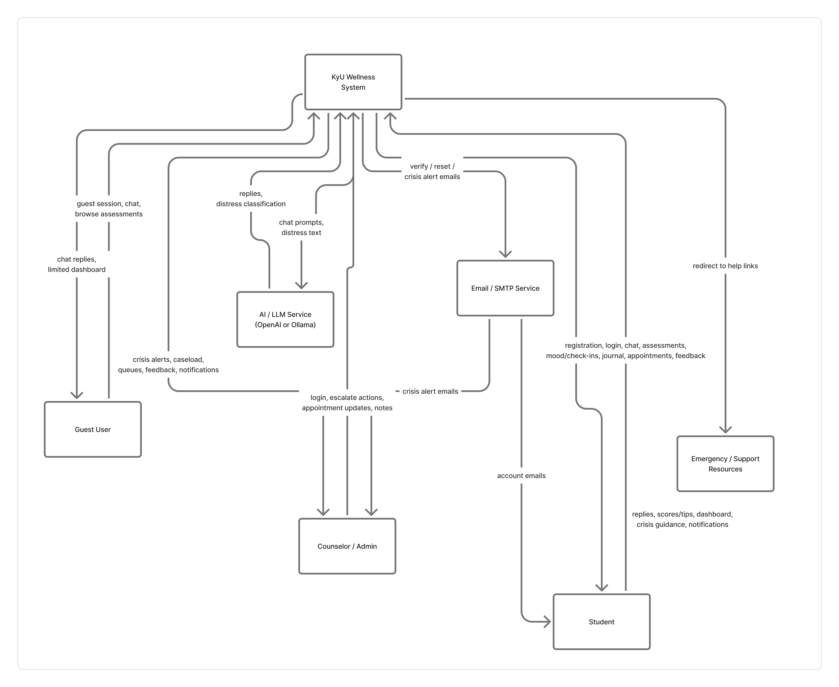
Context Diagram

Slide 18
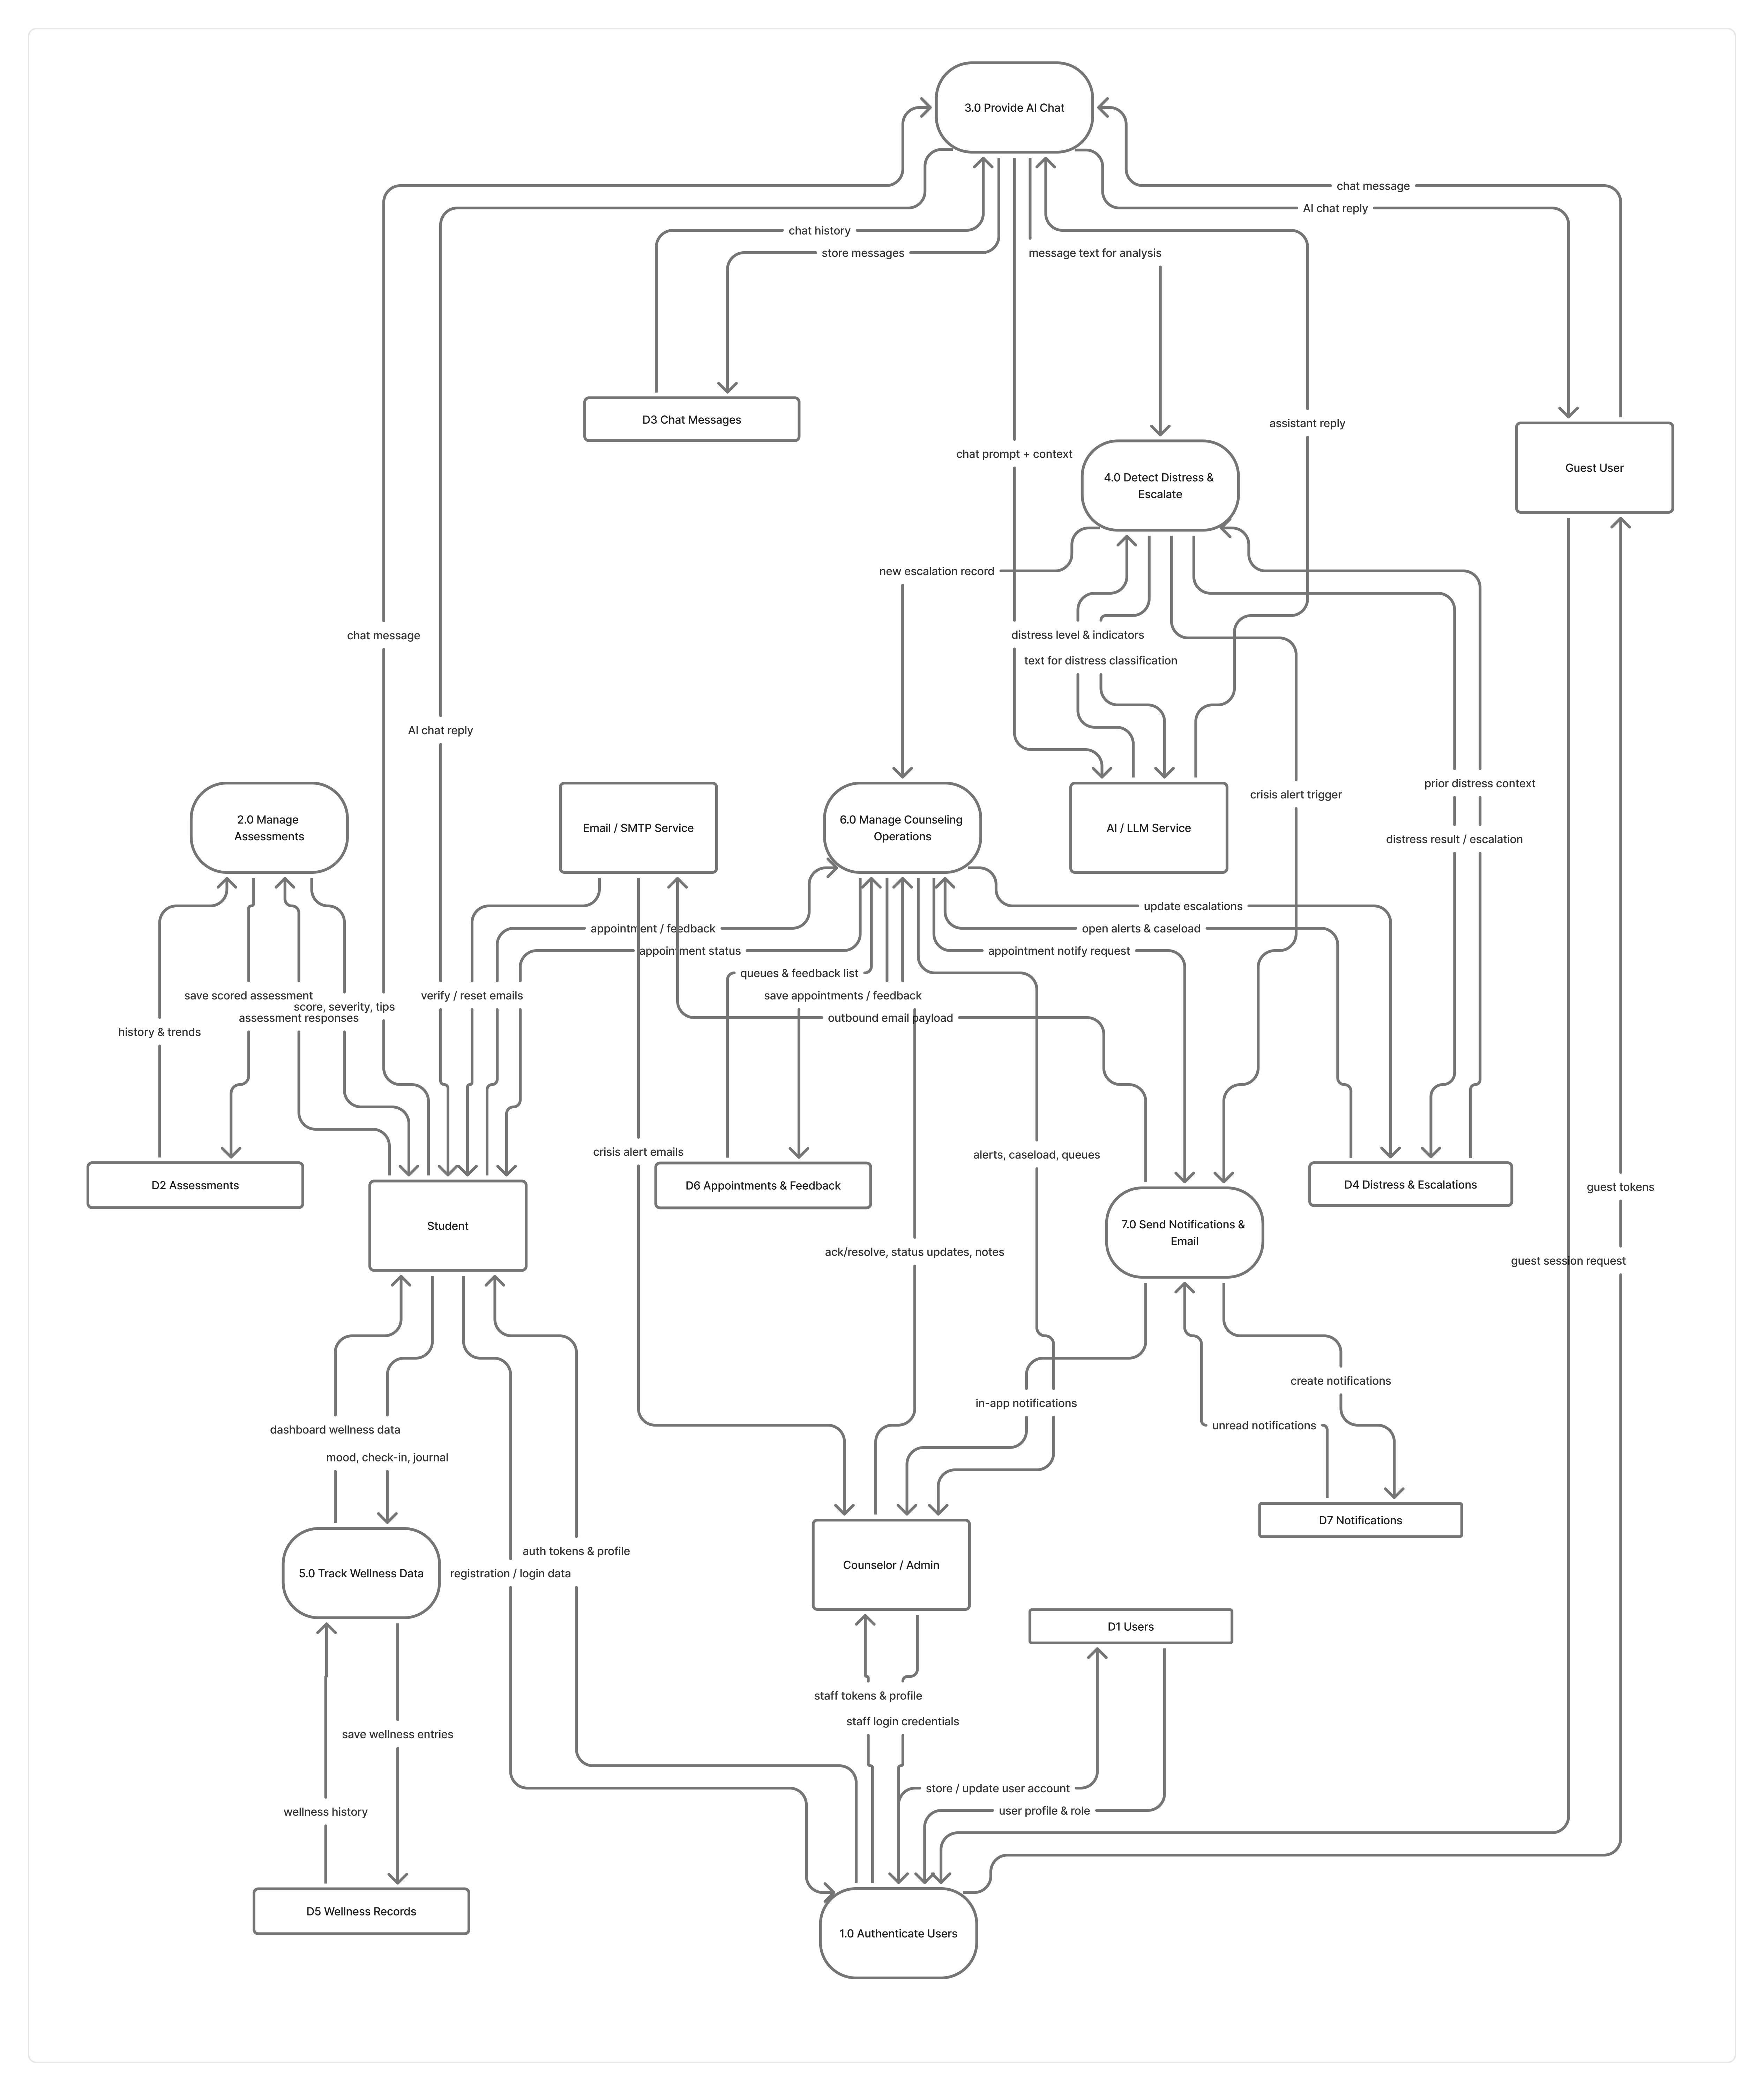
Level 0 dfd

Slide 19
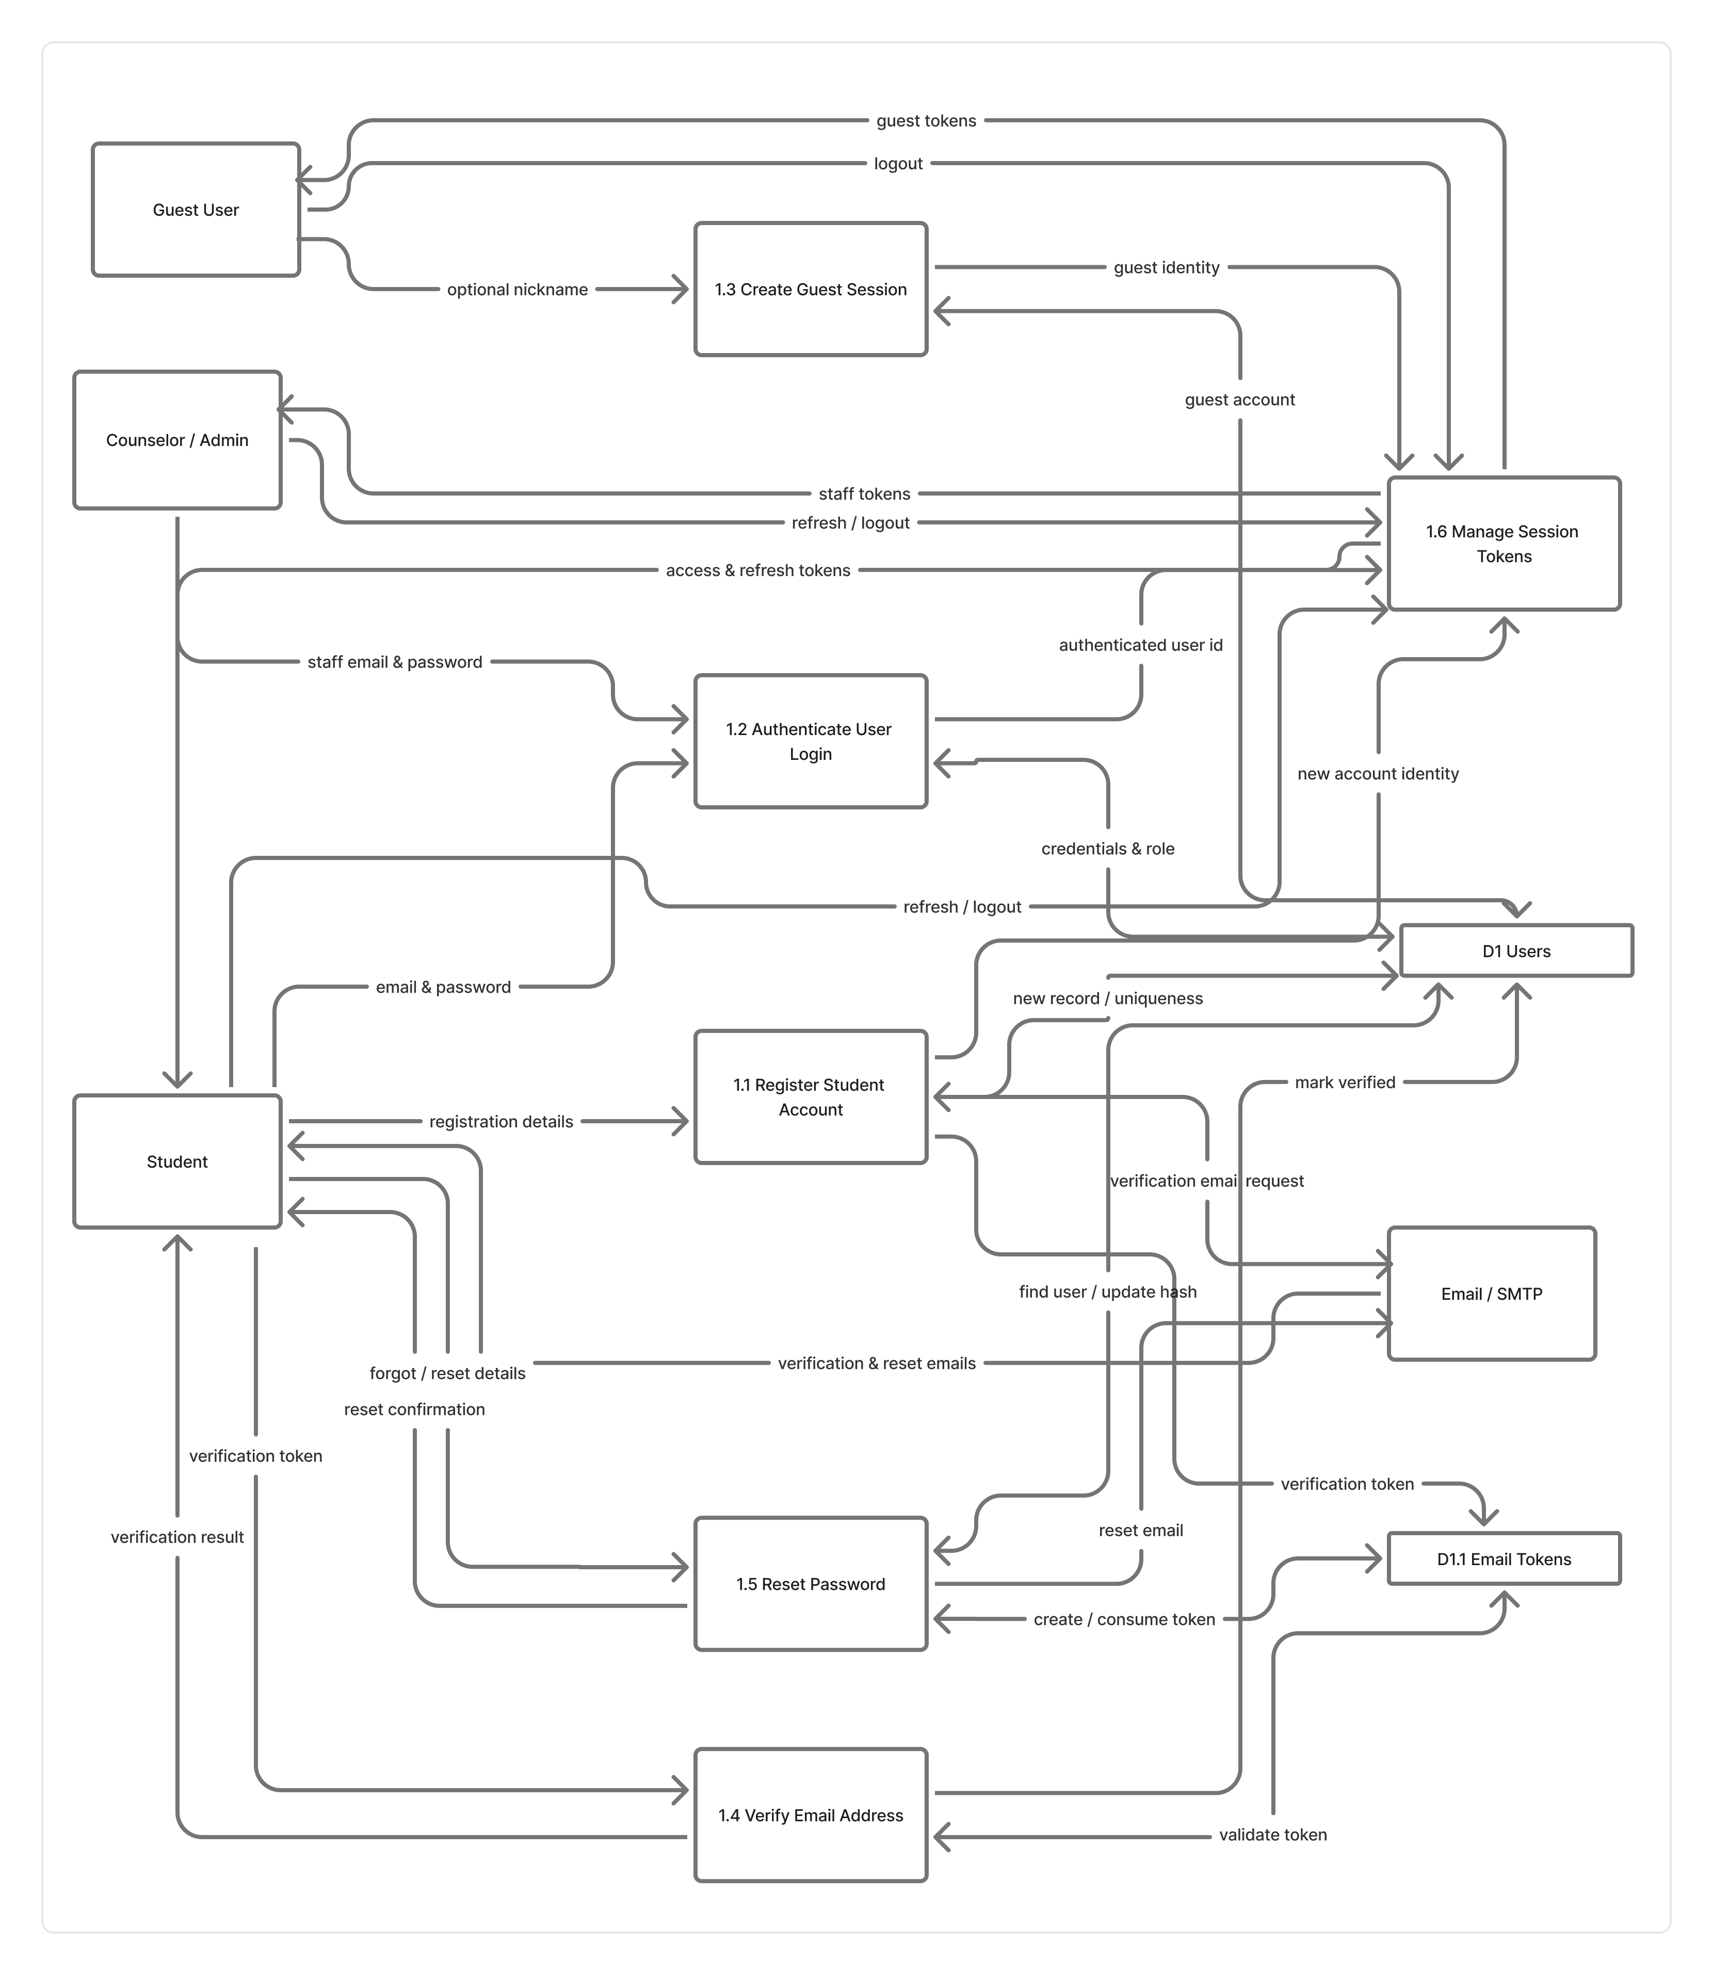
Level 1 dfd

Slide 20
System Design — Entity-Relationship Model
User is the central entity • PostgreSQL
• Entities: User, EmailToken, Assessment, ChatSession, ChatMessage, DistressResult, Escalation, Notification, MoodEntry, DailyCheckin, JournalEntry, Feedback, AppointmentRequest.
• Typical cardinality: User 1:N most records; ChatSession 1:N ChatMessage; ChatMessage 1:1 DistressResult.
• ERD guided SQLAlchemy models, Alembic migrations, PKs/FKs, and enum fields (role, severity, distress level).
User → Assessments
User → Chat sessions
Session → Messages
Message → Distress
User → Escalations
User → Notifications
KyU Wellness | Supervisor Presentation | August 2026
17

Slide 21
Architecture and Technology Stack
Frontend
React, Vite, TypeScript, Tailwind CSS, React Router
Backend API
Python FastAPI, Pydantic, JWT auth, role-based routes
Database
PostgreSQL 16 • SQLAlchemy • Alembic migrations
AI layer
Ollama (local LLM) • Hybrid rule + AI distress detection
Email
SMTP / Mailhog (verification, reset, crisis alerts)
DevOps
Docker Compose, pytest, Swagger/OpenAPI, Git
KyU Wellness | Supervisor Presentation | August 2026
18

Slide 22
Implementation Process
Iterative, modular development
1
Requirements & design
DFDs, ERD, architecture
2
Foundation setup
React, FastAPI, Postgres, Docker
3
Database
Models + Alembic migrations
4
Core modules
Auth → assess → chat → escalate
5
Integration
APIs, JWT, role-based UI
6
Test & refine
pytest, Swagger, browser tests
KyU Wellness | Supervisor Presentation | August 2026
19

Slide 23
Key System Features
Authentication
Screening tools
CBT-informed chat
Register, login, guest, email verify, password reset, JWT roles.
PHQ-9, GAD-7, PSS-10 with scoring and severity bands.
Supportive AI replies; no diagnosis; safety disclaimers.
Hybrid distress
Escalation
Counselor workspace
Rules + AI; crisis not downgraded; snapshot stored.
In-app + email alerts; counselor acknowledge/resolve.
Dashboard, caseload, appointments, feedback.
KyU Wellness | Supervisor Presentation | August 2026
20

Slide 24
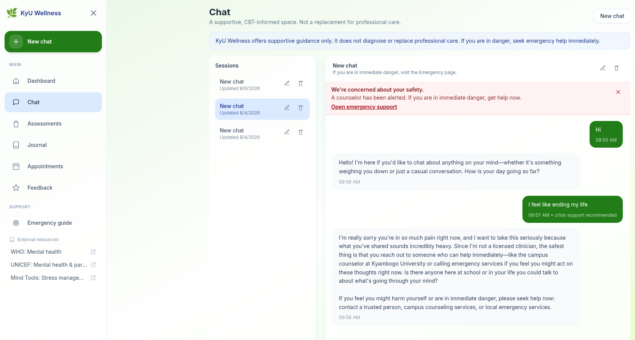
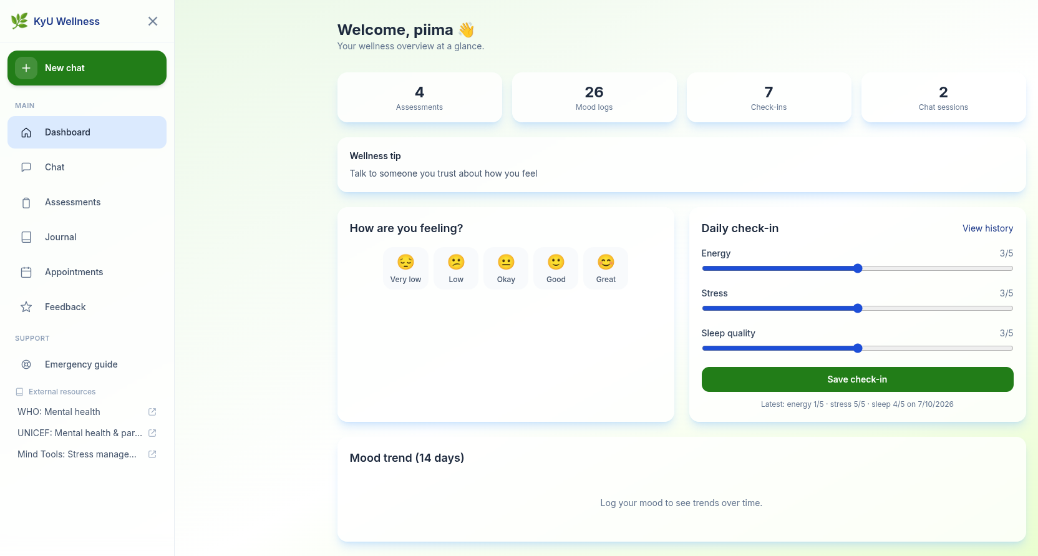
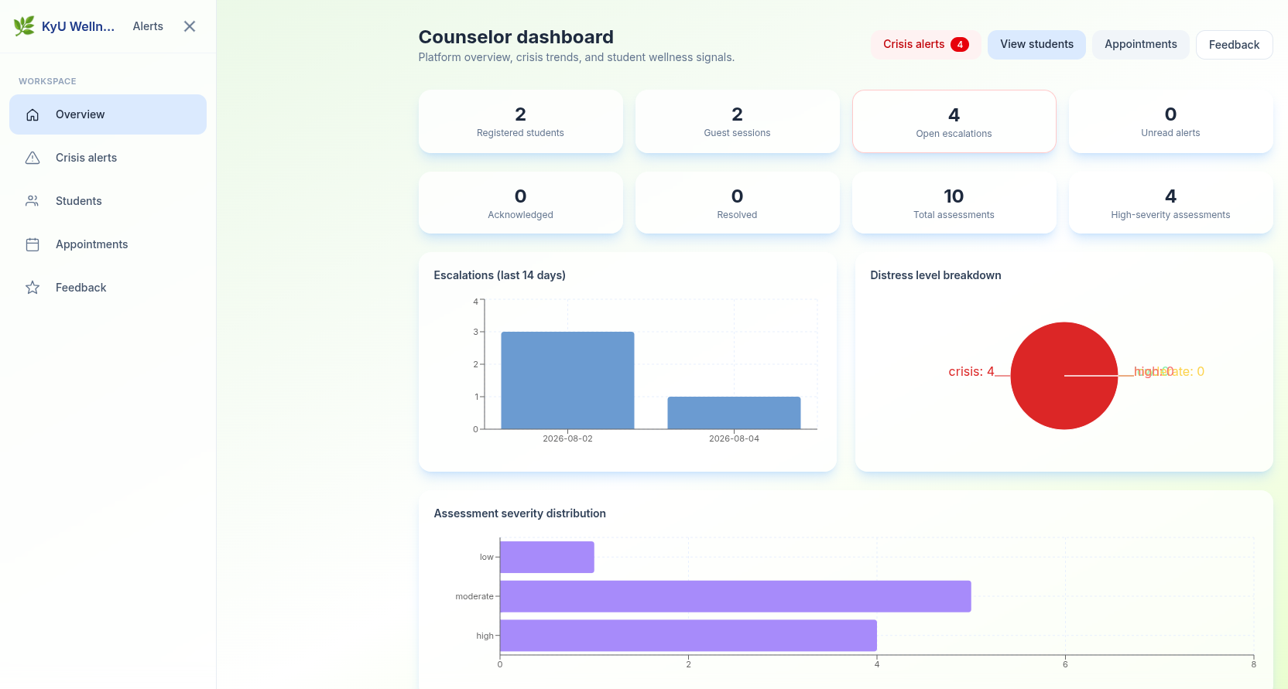
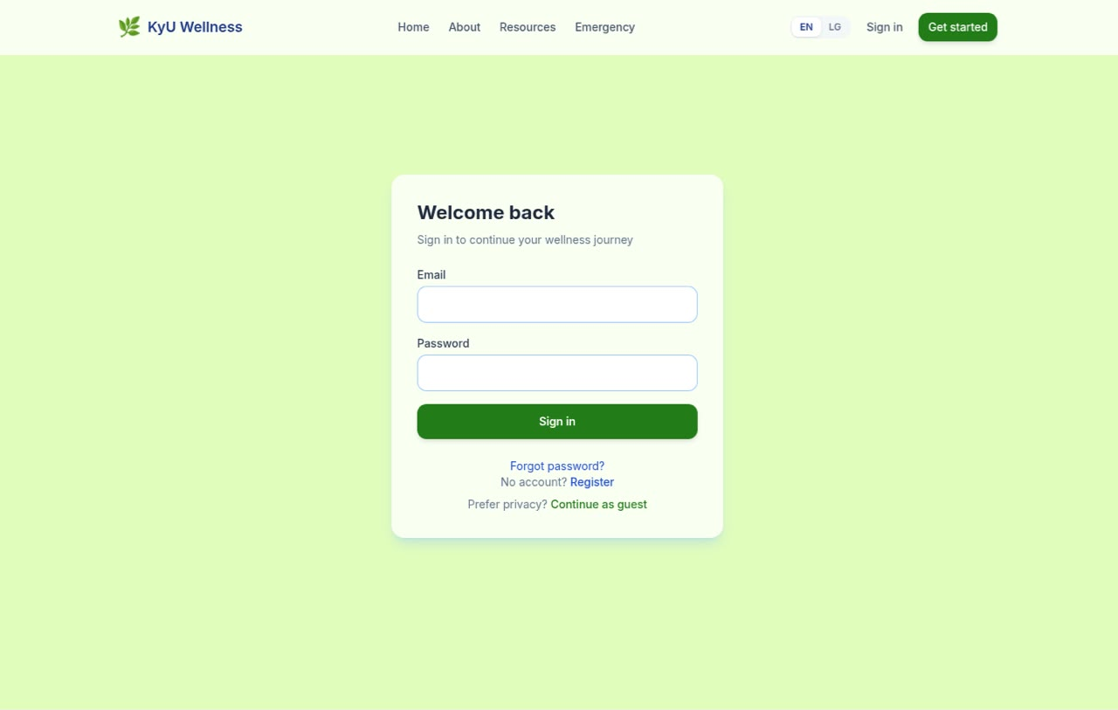
Implemented Interfaces
Selected screens from the working system
AI chat
Student dashboard
Landing page
Counselor dashboard
KyU Wellness | Supervisor Presentation | August 2026
21

Slide 25
Testing and Validation
Unit testing (pytest)
Integration & system testing
Hashing, JWT, PHQ-9/GAD-7/PSS-10 scoring, distress rules, schema validation.
Docker stack: React + FastAPI + Postgres + Mailhog + AI. Swagger and end-to-end workflows.
User acceptance testing
Validation
Student: register → assess → chat → mood → journal → appointment.
Counselor: alerts, caseload, escalations.
Checked against user requirements; data/security validation; rejected invalid input; blocked unauthorized access. Pilot in a controlled KyU development environment.
KyU Wellness | Supervisor Presentation | August 2026
22

Slide 26
Discussion of Findings
• Survey data (n = 79) confirmed high perceived stress and substantial moderate-plus depression/anxiety among KyU students.
• Students want anonymous, private AI support but still expect a path to human counselors — matching guest access plus escalation.
• The platform complements — does not replace — the Guidance and Counselling Unit.
• PHQ-9, GAD-7 and PSS-10 provide screening and counselor signals, not diagnoses.
• Hybrid distress detection plus escalation is the main technical contribution.
• Core workflows (auth, scoring, chat, escalation, wellness) were confirmed through testing and validation.
KyU Wellness | Supervisor Presentation | August 2026
23

Slide 27
Recommendations and Limitations
Recommendations
Limitations
• Train counseling staff on the dashboard
• Stronger privacy and data-retention policy
• Defined crisis response times
• Promote the platform to students
• Review AI prompts and distress rules with counselors
• Improve mobile and kiosk access
• Expand local-language support
• Not a clinical diagnostic or therapy system
• LLM quality and speed vary
• Testing mainly in a controlled environment
• Survey convenience sample, SCIS over-represented
• Needs internet and server uptime
• Escalation still depends on counselor availability
KyU Wellness | Supervisor Presentation | August 2026
24

Slide 28
Further Research and Conclusion
Further research
Large-scale usability/outcome study • Combined risk prediction • Deeper counselling-system integration • Native mobile apps • Luganda conversational support • Secure cloud deployment with privacy-preserving analytics.
Conclusion
The project designed, implemented and tested an AI-based conversational mental health support system for Kyambogo University. Survey analysis showed real student distress and demand for private AI support. The system delivers screening, CBT-informed chat, hybrid distress detection, crisis escalation and counselor tools, as a complement to professional care.
KyU Wellness | Supervisor Presentation | August 2026
25

Slide 29
Thank you
Questions and comments are welcome.
Supervisor: Dr. Busobozi Vivian Viola
Department of Computer Science • Kyambogo University • August 2026

